Slide 1
ATM SYSTEM (OOP)
GROUP MEMBERS
SHAKILA BIBI
AYESHA SHABBIR
ABIDA BIBI
RAFIA SHABAZ
PRESENTED TO
MAM HOREEN KHAN
LAHORE GARRISION UNIVERSITY
IT DEPARTMENT111
2ND SEMESTER

Slide 2
CONTENTS
Introduction
Working
Techniques used
Deposit cash
Withdraw cash
Account Details
Pay Bills
Pay Account Interest
Exit Program
Conclusion

Slide 3
INTRODUCTION
ATM is an electronic banking outlet that allows customers to complete basic transactions without the aid of a branch representative or teller.
Anyone with a credit card or debit card can access cash at ATMs.
Some are simple cash dispensers while others allow a variety of transactions such as check deposits, balance transfers, and bill payments.
Consumers are authenticated by a PIN before any transaction can be made.

Slide 4
WORKING
The users insert the card into ATMs to access the account.
User can access account by entering a pin.
Main menu appear and user can do following functions
Deposit cash
Withdraw cash
Check Balance
Pay Bills
Pay Account Interest

Slide 5
TECHNIQUES USED
Classes and Objects
Inheritance
File Handling
Manipulators
goto start
Constructor
Functions
Switch Statements
Current Date and Time
Colour Window Screen
Do While Loop
If Else Statement

Slide 6
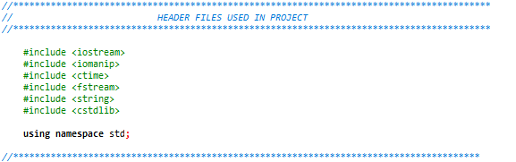
HEADER FILES

Slide 7
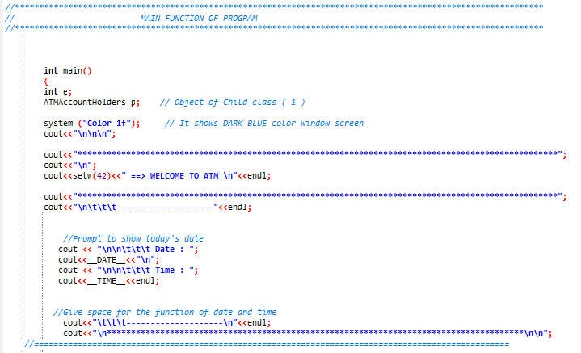
MAIN FUNCTION

Slide 8
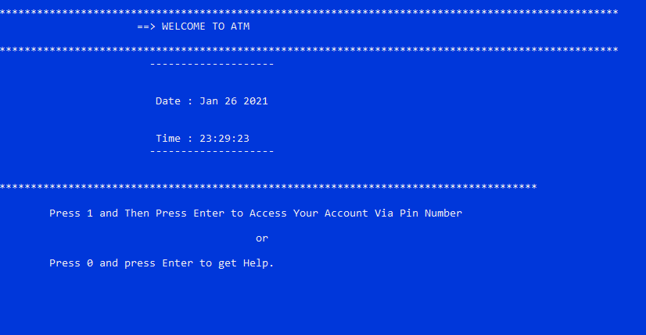
WELCOME SCREEN

Slide 9
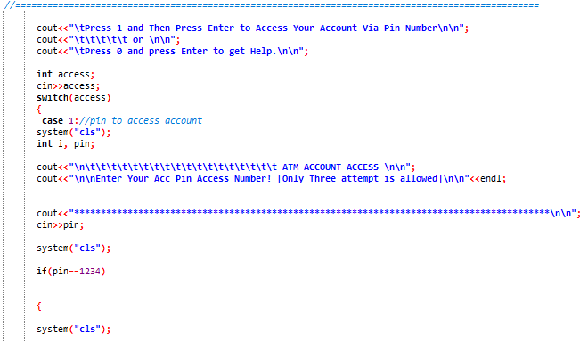
TAKING PIN FROM USER

Slide 10
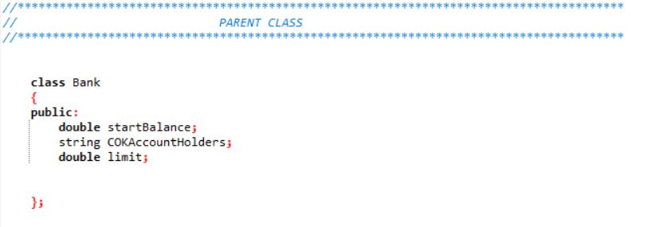
PARENT CLASS

Slide 11
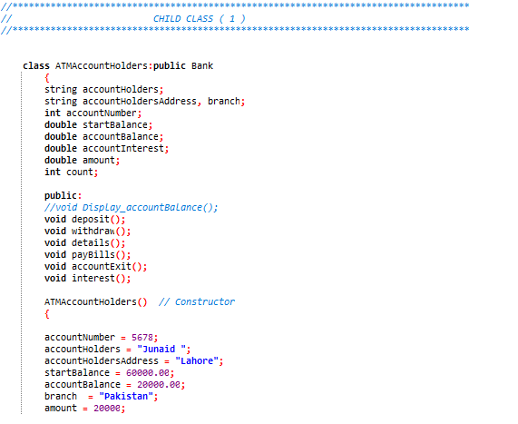
CHILD CLASSES
CHILD CLASS 1:

Slide 12
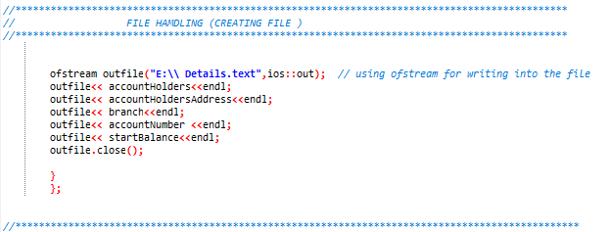
FILE HANDLING

Slide 13
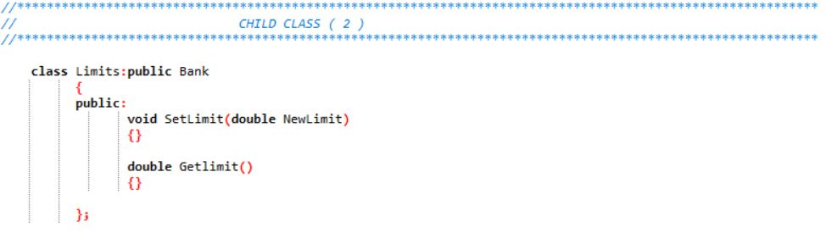
CHILD CLASSES
CHILD CLASS 2:

Slide 14
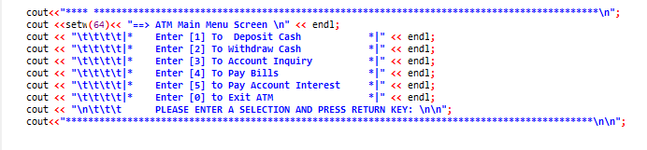
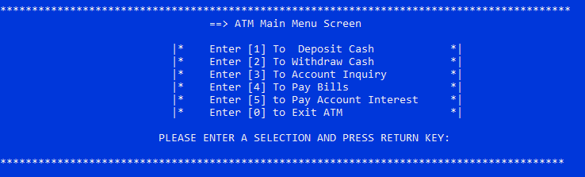
MAIN SCREEN (MODULES)
CODE:
OUTPUT:

Slide 15
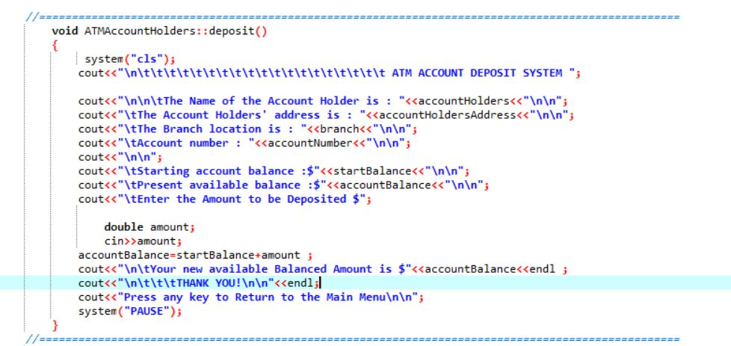
DEPOSIT CASH

Slide 16
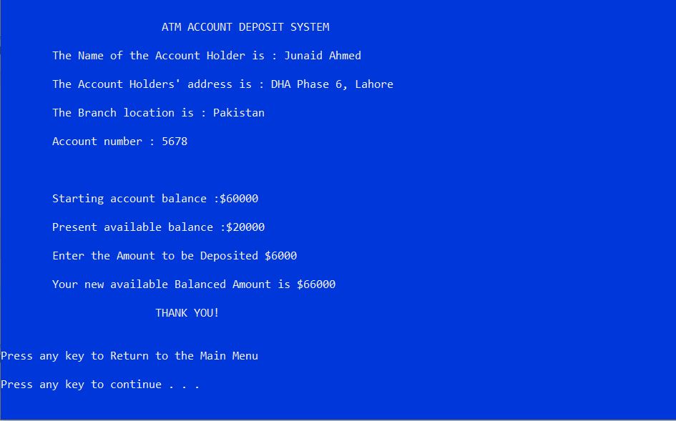
DEPOSIT CASH

Slide 17
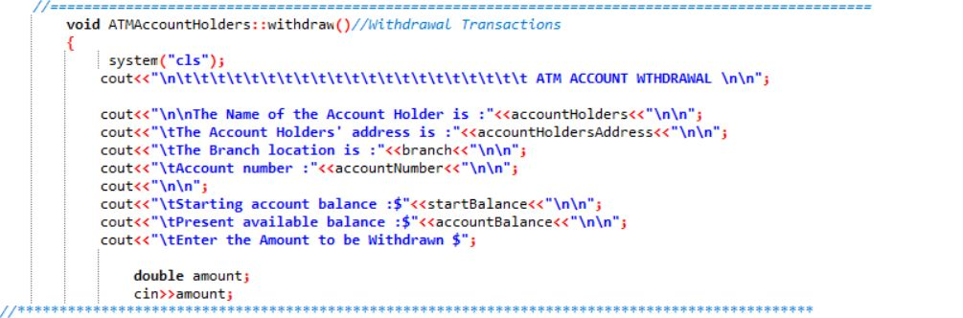
WITHDRAW CASH

Slide 18
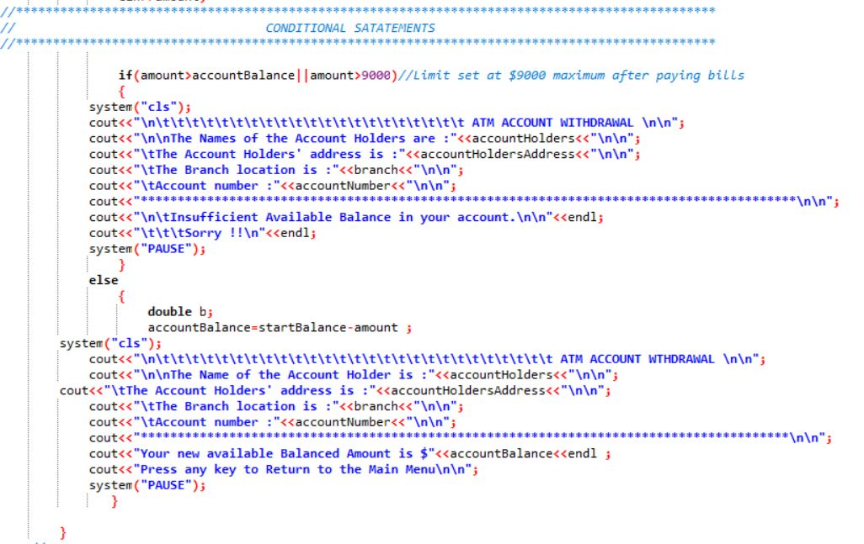
WITHDRAW CASH

Slide 19
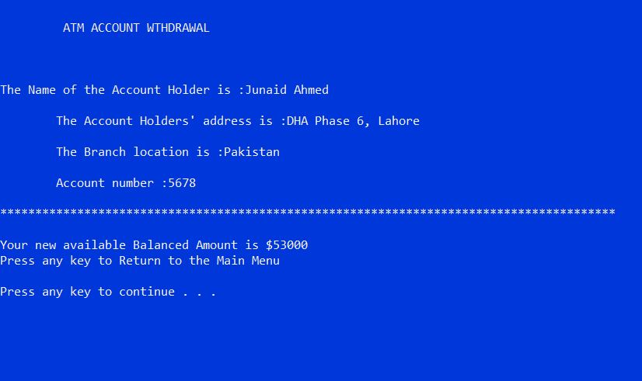
WITHDRAW CASH

Slide 20
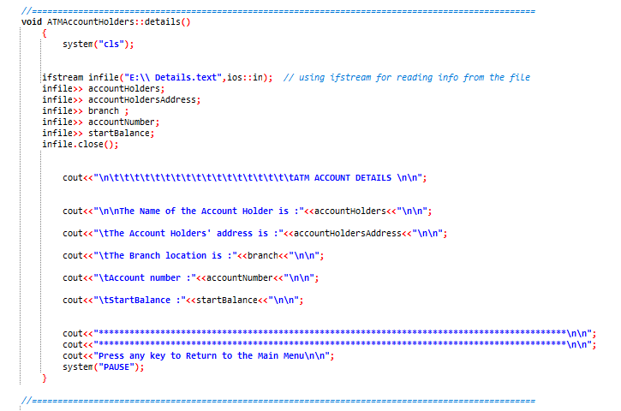
ACCOUNT DETAILS

Slide 21
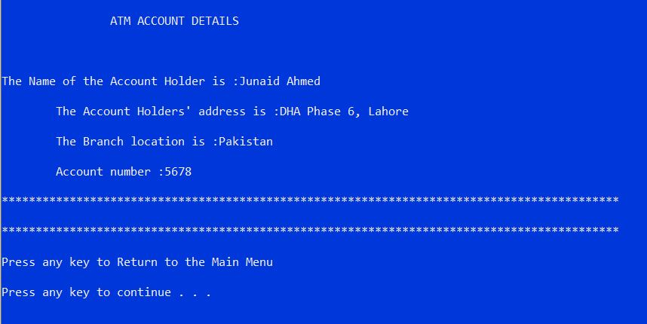
ACCOUNT DETAILS

Slide 22
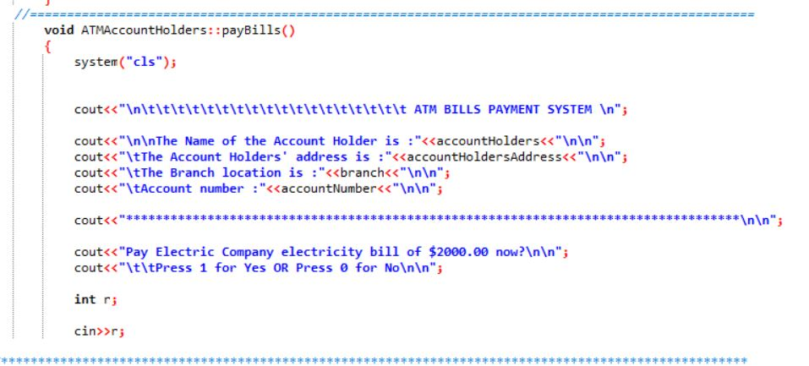
PAY BILLS

Slide 23
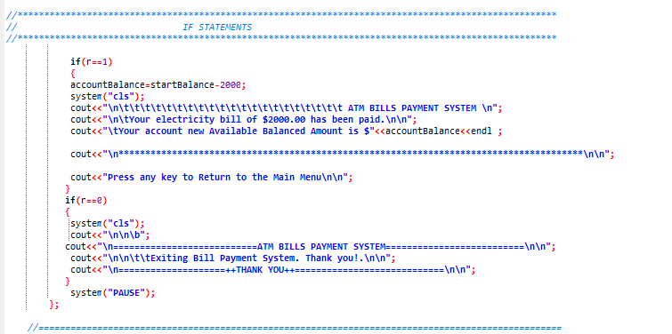
PAY BILLS

Slide 24
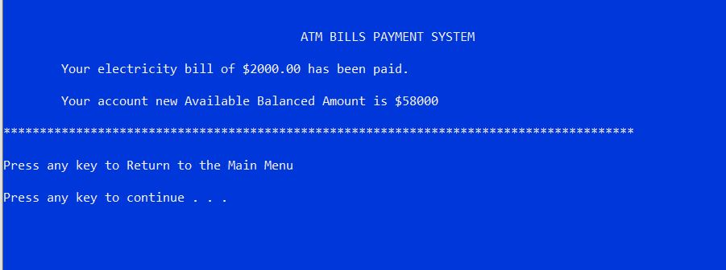
PAY BILLS

Slide 25
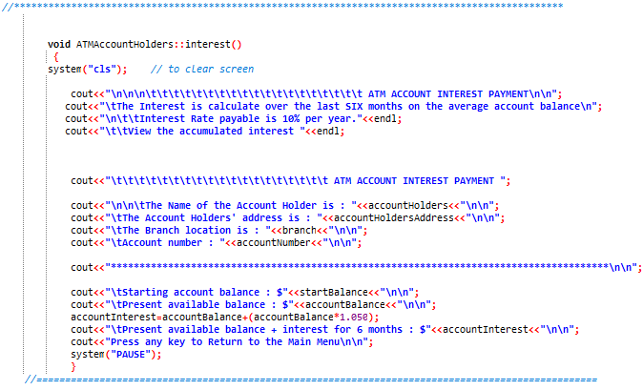
PAY ACCOUNT INTEREST

Slide 26
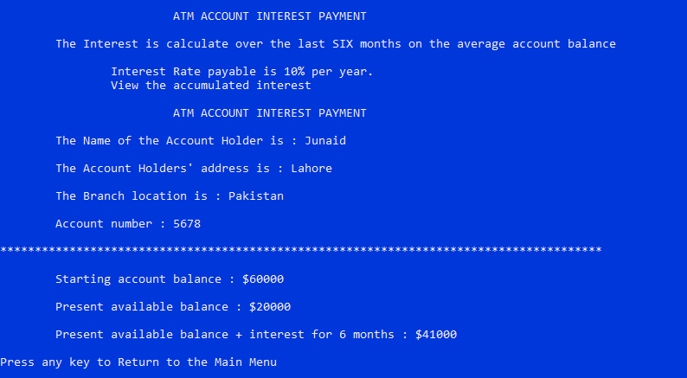
PAY ACCOUNT INTEREST

Slide 27
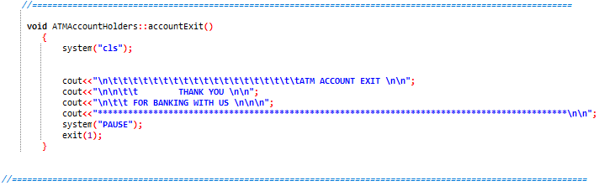
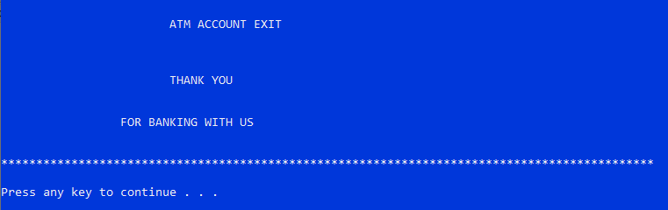
EXIT ACCOUNT
CODE:
OUTPUT:

Slide 28
CONCLUSION
ATM come in a variety of form and sizes all to serve on goal; bring the bank closer to the user.
The system is designed to provide the user with the facility of remote banking and perform various other functions at an interface without any aid of human bank teller.
It is a fast way to get money out of your account, especially when on the go or during a trip.
When one looks at the different ATM they all share several operations such that withdrawal and View Balance.

Slide 29


